Slide 1








GAME START

Slide 2
Video Game Global Sales Analysis
arcade
mystery
science
adventure

Slide 3
Goal
Audience
Use Case
Analyze sales patterns for Marketing
Analyze Top genres and platforms to develop strategies
strategic investment decisions
Understanding Market Trends.
Optimizing Business Strategies
Enhancing User Experience
Marketing Professionals:
Game Developers
Investors and Publishers:

Slide 4

Analysis - Regression
Dependent (y) – Global Sales
Independent (x)- other regional Sales
-r- Square = 91.58%
• NA_Sales coefficient (0.8384)
• EU_Sales coefficient (1.1834)
• Japan_Sales coefficient (0.9324)
• Other_Sales coefficient (0.416957)

Slide 5


Slide 6
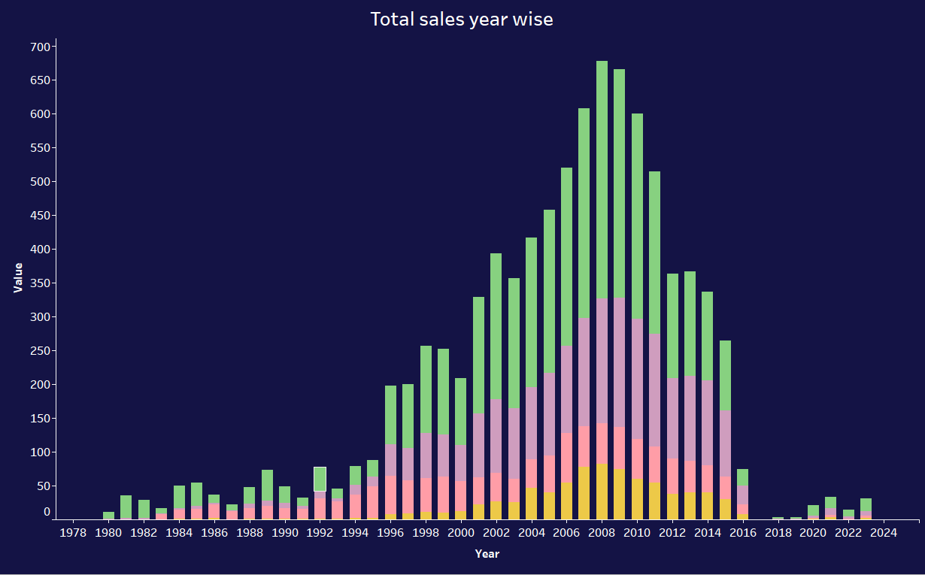
Sales trend over time

Slide 7
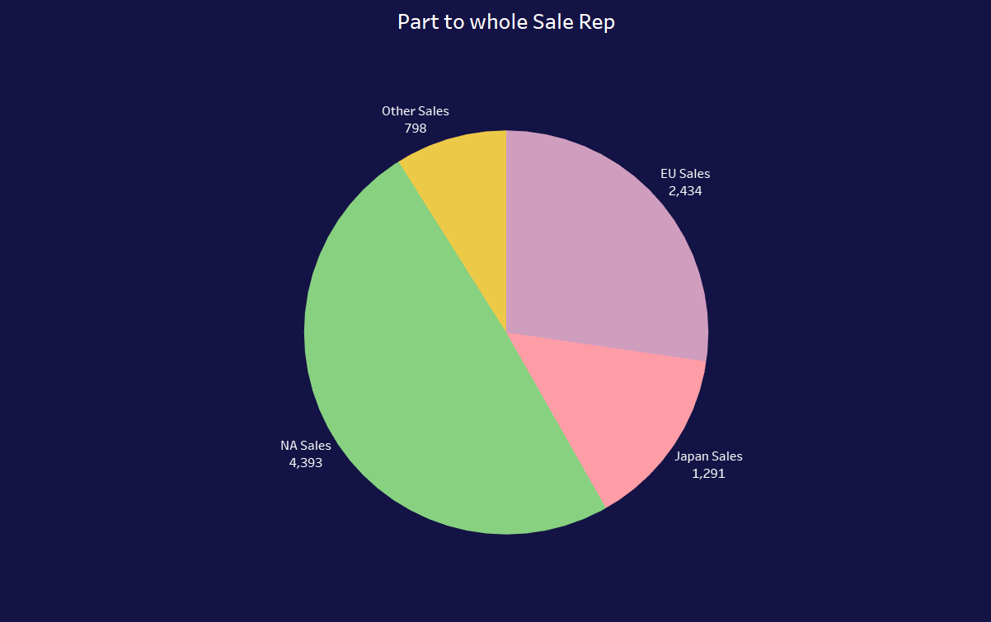
Sales trend over time

Slide 8
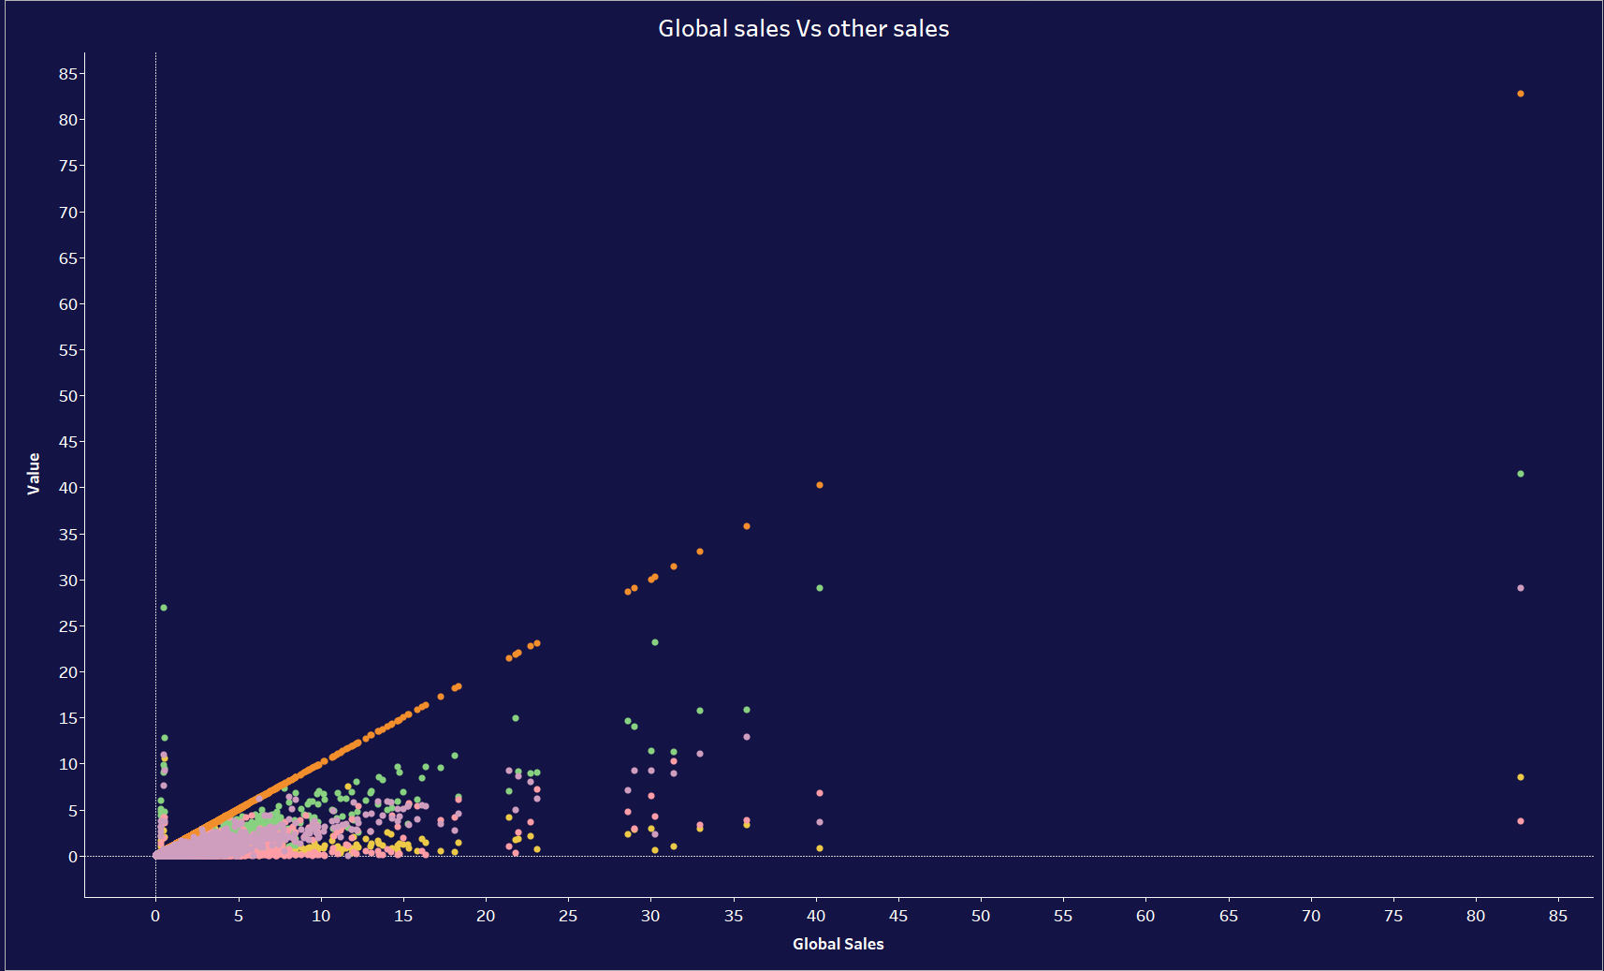
Correlation

Slide 9
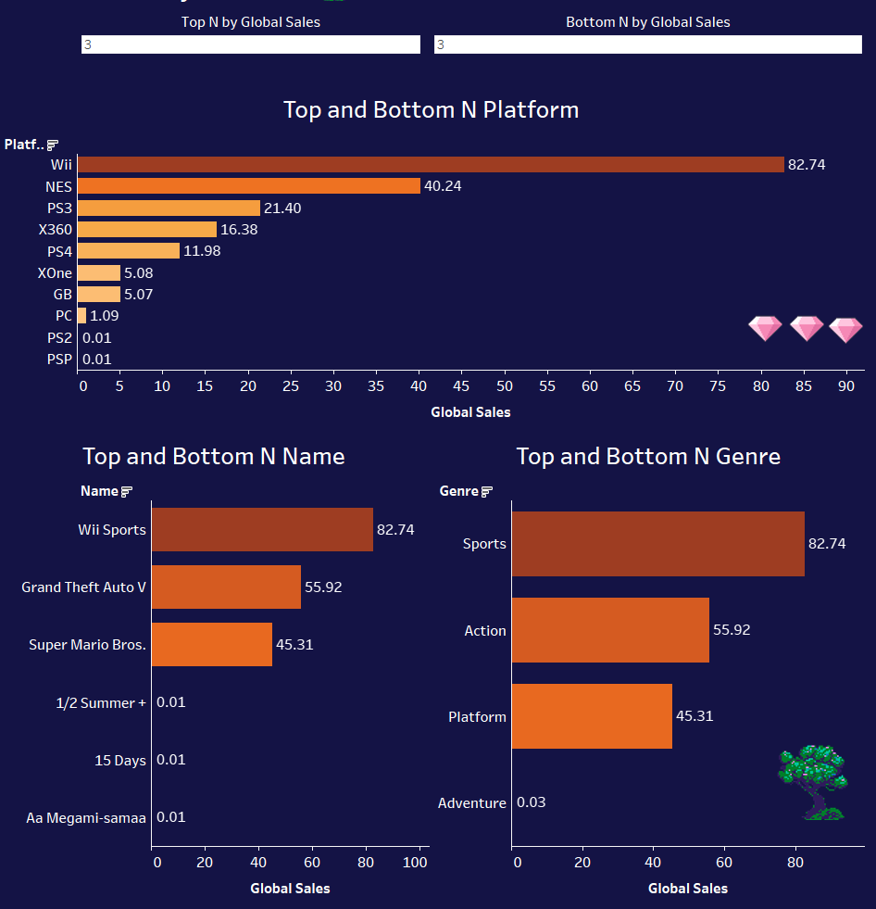
Top n & bottom N by sales

Slide 10
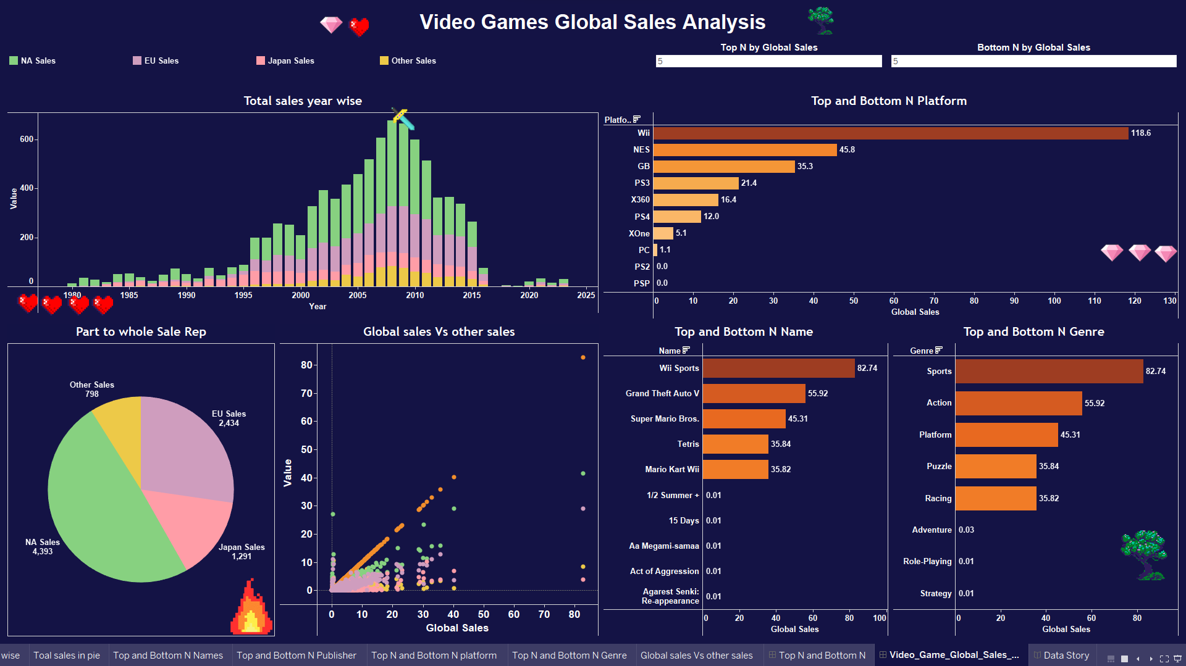

Slide 11
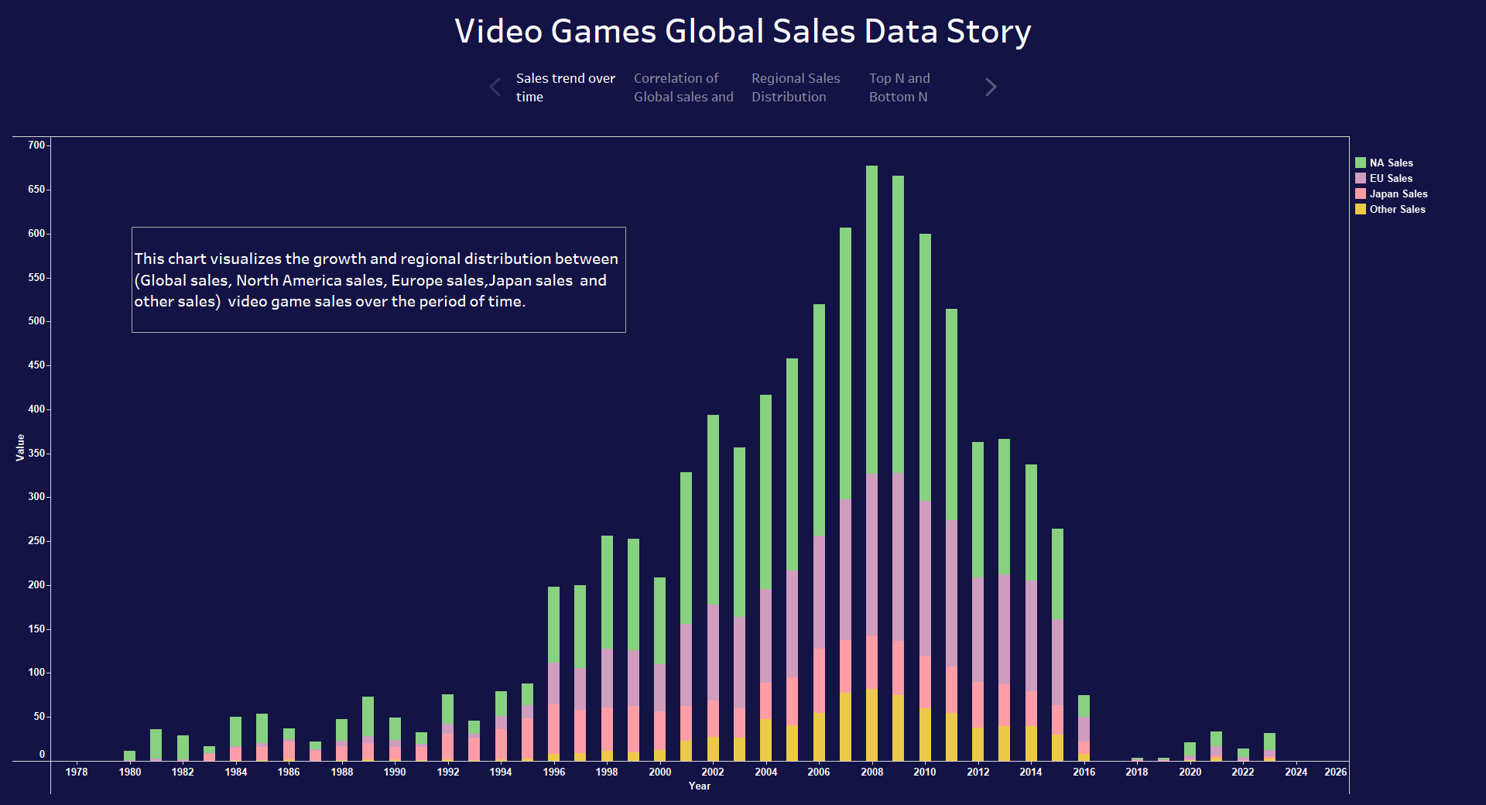

Slide 12
THANK YOU FOR PLAYING WITH US!

